Slide 1
Chapter 5: Switch Configuration
CCNA Routing and Switching
Routing and Switching Essentials v6.0
Notes:
Cisco Networking Academy Program
Routing and Switching Essentials v6.0
Chapter 5: Switch Configuration

Slide 2
Chapter 5 - Sections & Objectives
5.1 Basic Switch Configuration
Configure basic switch settings to meet network requirements.
Configure initial settings on a Cisco switch.
Configure switch ports to meet network requirements.
5.2 Basic Device Configuration
Configure a switch using security best practices in a small to medium-sized business network.
Configure the management virtual interface on a switch.
Configure the port security feature to restrict network access.
Notes:
2
Cisco Networking Academy Program
Routing and Switching Essentials v6.0
Chapter 5: Switch Configuration

Slide 3
5.1 Configure a Switch with Initial Settings
Notes:
5 – Switch Configuration
5.1 – Configure a Switch with Initial Settings

Slide 4
Configure a Switch with Initial Settings Switch Boot Sequence
When a switch is powered on, the boot sequence occurs.
Power-on self-test (POST), a program stored in ROM, executes and checks hardware like CPU and RAM.
The boot loader, also stored in ROM, runs and initializes parts within the CPU, initializes the flash file system, and then locates and loads an IOS image.
The IOS image can be defined within the BOOT environment variable.
If the variable is not set, the switch scours through the flash file system searching for an executable image file, loading it into RAM, and launching it if found.
If an executable image file is not found, the switch shows the prompt switch: where a few commands are allowed in order to provide access to operating system files found in flash memory and files used to load or reload an operating system.
If an IOS operating system loads, the switch interfaces are initialized and any commands stored in the startup-config file load.
The startup-config file is stored in NVRAM.
Notes:
5.1 – Basic Switch Configuration
5.1.1 – Configure a Switch with Initial Settings
5.1.1.1 – Switch Boot Sequence

Slide 5
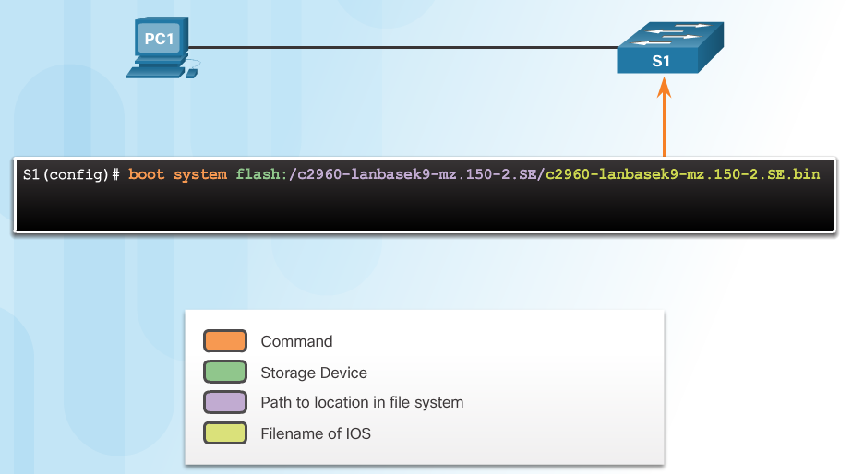
Configure a Switch with Initial Settings Switch Boot Sequence (Cont.)
The boot system command is use to set the BOOT environment variable.
Notes:
5.1 – Basic Switch Configuration
5.1.1 – Configure a Switch with Initial Settings
5.1.1.1 – Switch Boot Sequence

Slide 6
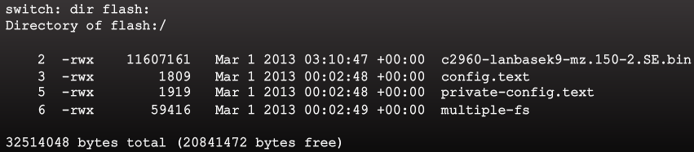
Configure a Switch with Initial Settings Recovering From a System Crash
The boot loader prompt can be accessed through a console connection to the switch:
1. Cable the PC to the switch console port.
2. Configure the terminal emulation software on the PC.
3. Unplug the switch power cord.
4. Reconnect the power cord and at the same time or within 15 seconds, press and hold the Mode button on the front of the switch until the System LED turns an amber color briefly and then turns a solid green.
The boot loader command prompt is switch: (instead of Switch>).
The commands available through the boot loader command prompt are limited.
Use the help command to display the available commands.
Notes:
5.1 – Basic Switch Configuration
5.1.1 – Configure a Switch with Initial Settings
5.1.1.2 – Recovering From a System Crash

Slide 7
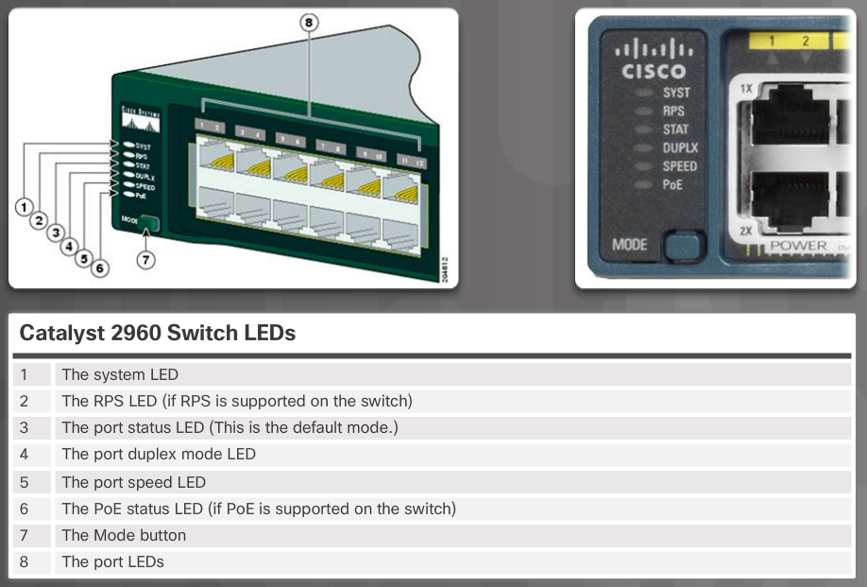
Configure a Switch with Initial Settings Switch LED Indicators
System LED shows if the switch has power applied.
Port LED states:
Off – no link or shut down
Green – link is present
Blinking green – data activity
Alternating green and amber – link fault
Amber – port is not sending data; common for first 30 seconds of connectivity or activation
Blinking amber – port is blocking to prevent a switch loop
Notes:
5.1 – Basic Switch Configuration
5.1.1 – Configure a Switch with Initial Settings
5.1.1.3 – Switch LED Indicators

Slide 8
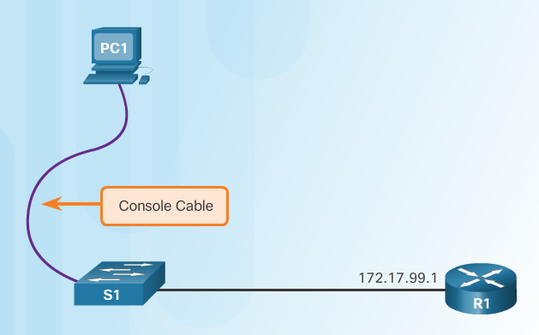
Configure a Switch with Initial Settings Preparing for Basic Switch Management
To configure a switch for remote access, the switch must be configured with an IP address, subnet mask, and default gateway.
One particular switch virtual interface (SVI) is used to manage the switch:
A switch IP address is assigned to an SVI.
By default the management SVI is controlled and configured through VLAN 1.
The management SVI is commonly called the management VLAN.
For security reasons, it is best practice to use a VLAN other than VLAN 1 for the management VLAN.
Remember that the switch console port is on the back of the switch.
Notes:
5.1 – Basic Switch Configuration
5.1.1 – Configure a Switch with Initial Settings
5.1.1.4 – Preparing for Basic Switch Management

Slide 9
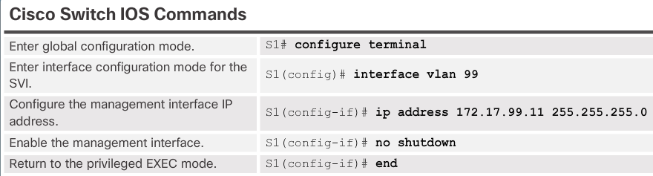
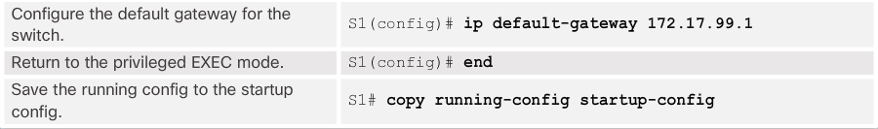
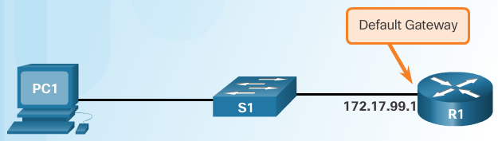
Configure a Switch with Initial Settings Configuring Basic Switch Management Access with IPv4
exit
Important Concept
The default gateway is the router address and is used by the switch to communicate with other networks.
Notes:
5.1 – Basic Switch Configuration
5.1.1 – Configure a Switch with Initial Settings
5.1.1.5 – Configuring Basic Switch Management Access with IPv4

Slide 10
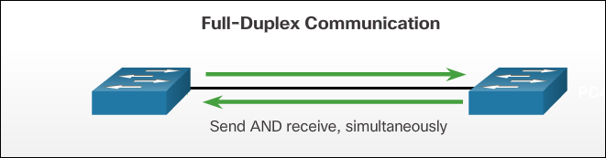
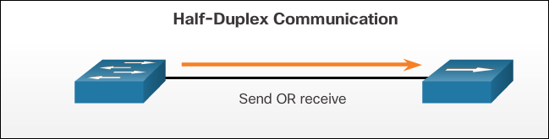
Configure Switch Ports Duplex Communication
Gigabit Ethernet and 10Gb Ethernet NICs require full-duplex connections to operate.
Bidirectional communication
Unidirectional communication
Notes:
5.1 – Basic Switch Configuration
5.1.2 – Configure Switch Ports
5.1.2.1 – Duplex Communication

Slide 11
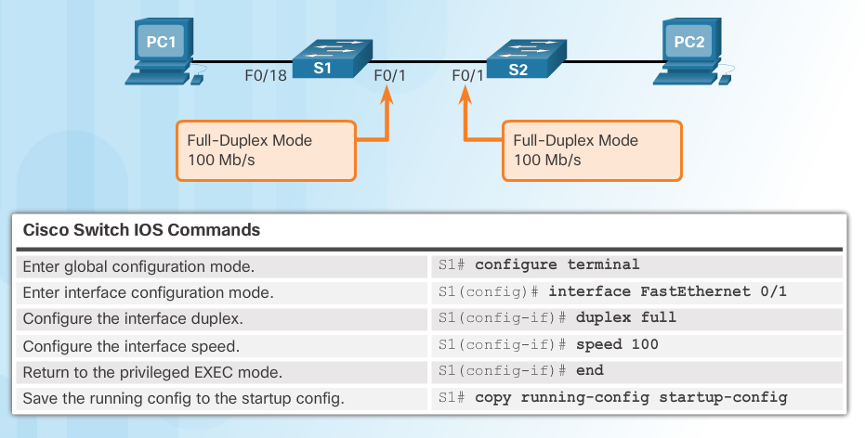
Configure Switch Ports Configure Switch Ports at the Physical Layer
Some switches have the default setting of auto for both duplex and speed.
Mismatched duplex and/or speed settings can cause connectivity issues.
Always check duplex and speed settings using the show interface interface_id command.
All fiber ports operate at one speed and are always full-duplex.
Notes:
5.1 – Basic Switch Configuration
5.1.2 – Configure Switch Ports
5.1.2.2 – Configure Switch Ports at the Physical Layer

Slide 12
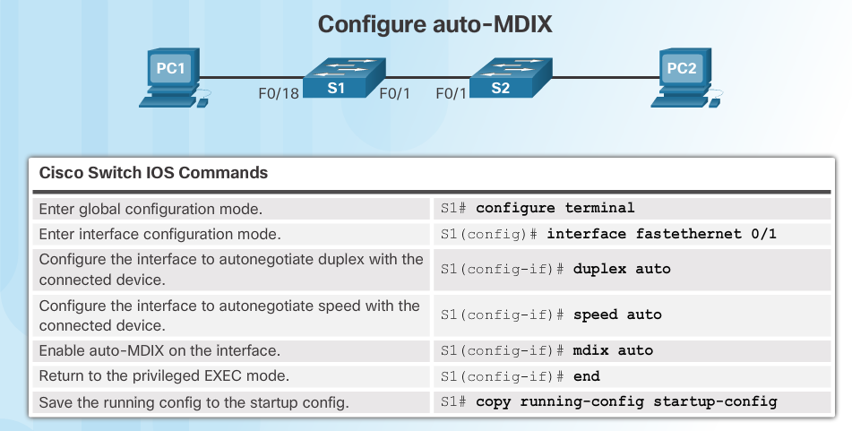
Configure Switch Ports Auto-MDIX
Some switches have the automatic medium-dependent interface crossover (auto-MDIX) feature that allows an interface to detect the required cable connection type (straight-through or crossover) and configure the connection appropriately.
Notes:
5.1 – Basic Switch Configuration
5.1.2 – Configure Switch Ports
5.1.2.3 – Auto-MDIX

Slide 13
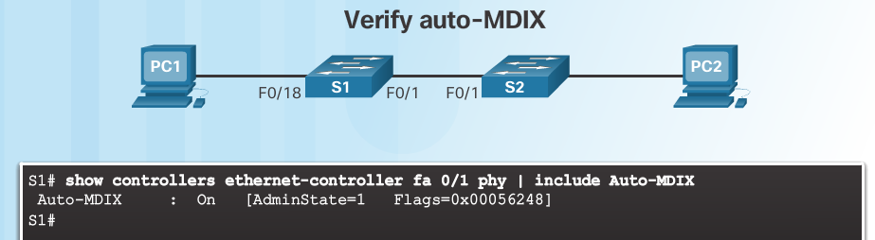
Configure Switch Ports Auto-MDIX (Cont.)
Use the show controllers Ethernet-controller command to verify auto-MDIX settings.
Notes:
5.1 – Basic Switch Configuration
5.1.2 – Configure Switch Ports
5.1.2.3 – Auto-MDIX (Cont.)

Slide 14
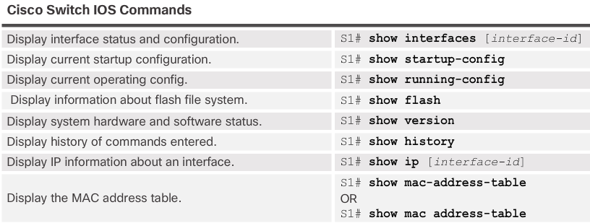
Configure Switch Ports Verifying Switch Port Configuration
Notes:
5.1 – Basic Switch Configuration
5.1.2 – Configure Switch Ports
5.1.2.4– Verifying Switch Port Configuration

Slide 15
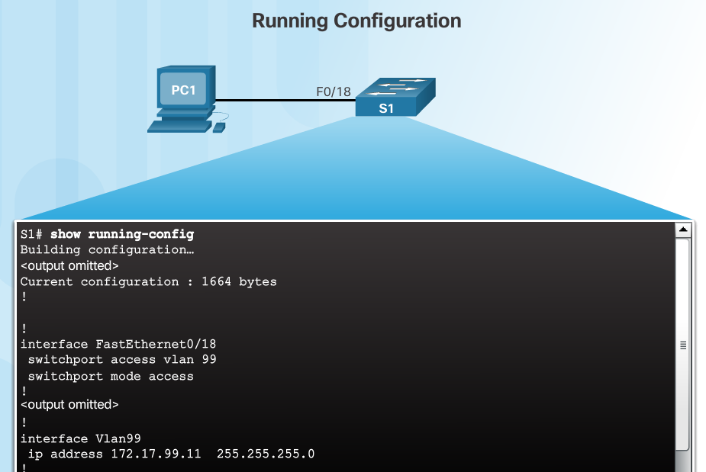
Configure Switch Ports Verifying Switch Port Configuration (Cont.)
Notes:
5.1 – Basic Switch Configuration
5.1.2 – Configure Switch Ports
5.1.2.4– Verifying Switch Port Configuration (Cont.)

Slide 16
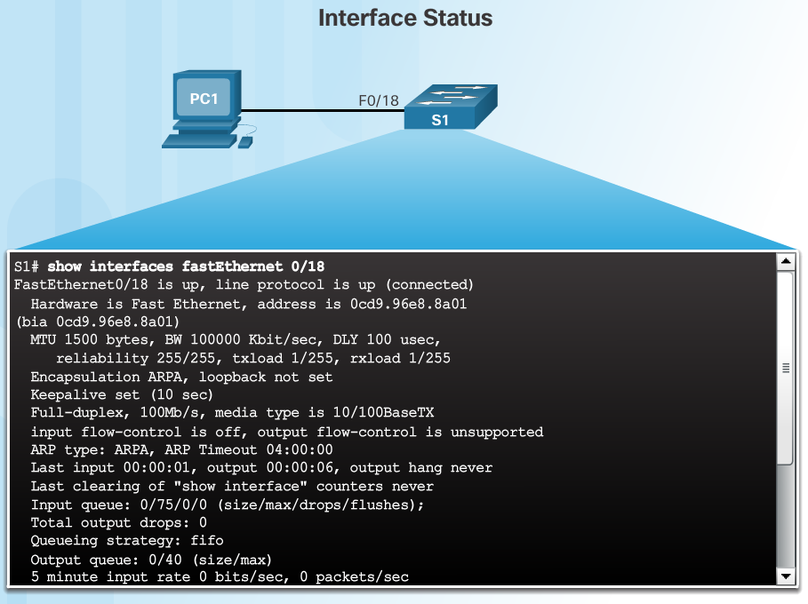
Configure Switch Ports Verifying Switch Port Configuration (Cont.)
Layer 1 OK
Layer 2 OK
Notes:
5.1 – Basic Switch Configuration
5.1.2 – Configure Switch Ports
5.1.2.4– Verifying Switch Port Configuration (Cont.)

Slide 17
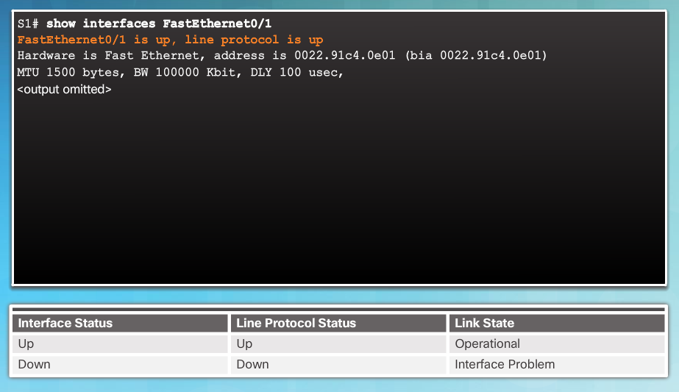
Configure Switch Ports Network Access Layer Issues
Use the show interfaces command to detect common media issues.
The first parameter refers to Layer 1, the physical layer, and indicates if the interface is receiving a carrier detect signal.
The second parameter (protocol status) refers to the data link layer and indicates whether the data link layer protocol has been configured correctly and keepalives are being received.
Notes:
5.1 – Basic Switch Configuration
5.1.2 – Configure Switch Ports
5.1.2.5 – Network Access Layer Issues

Slide 18
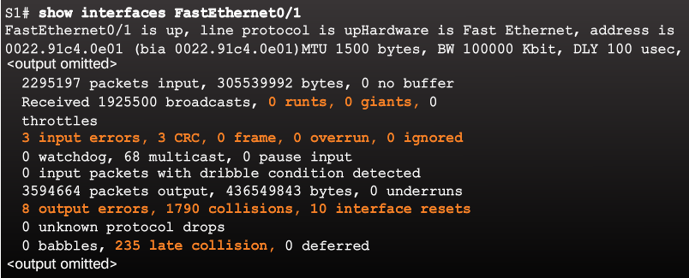
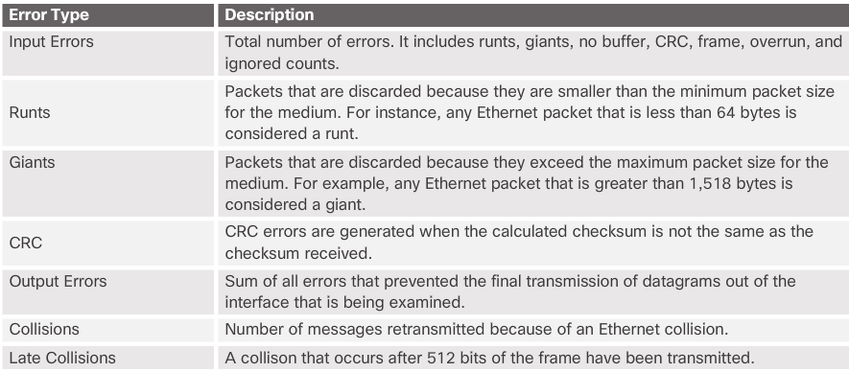
Configure Switch Ports Network Access Layer Issues (Cont.)
Notes:
5.1 – Basic Switch Configuration
5.1.2 – Configure Switch Ports
5.1.2.5 – Network Access Layer Issues (Cont.)

Slide 19
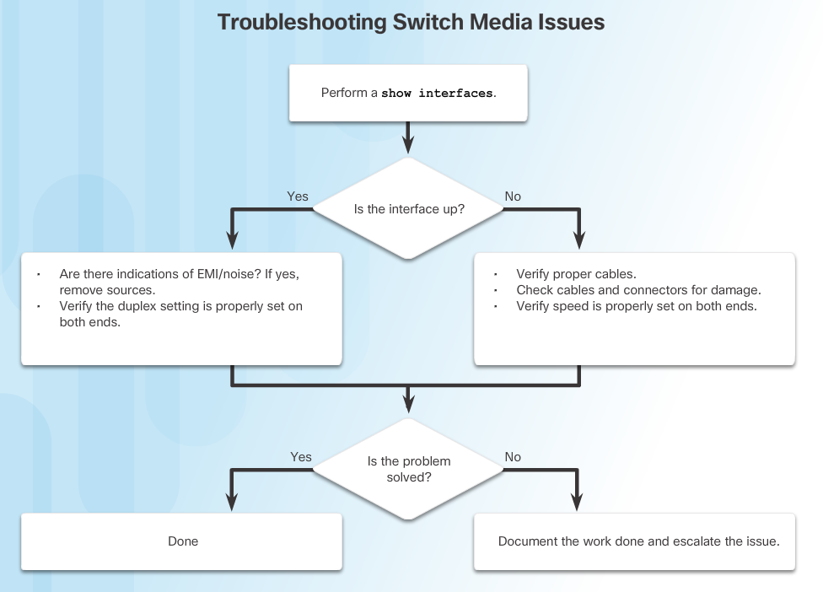
Configure Switch Ports Troubleshooting Network Access Layer Issues
Notes:
5.1 – Basic Switch Configuration
5.1.2 – Configure Switch Ports
5.1.2.6– Troubleshooting Network Access Layer Issues

Slide 20
5.2 Switch Security
Notes:
5 - Switch Configuration
5.2 – Switch Security

Slide 21
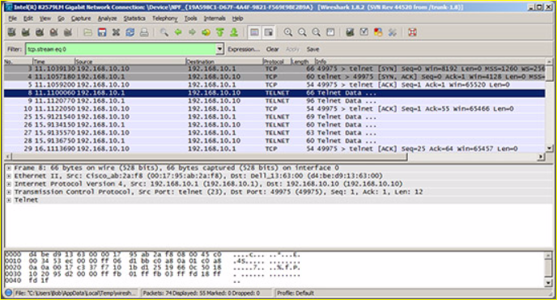
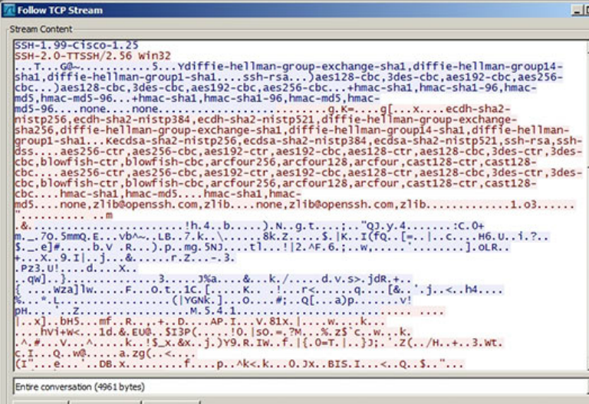
Secure Remote Access SSH Operation
Secure Shell (SSH)
An alternative protocol to Telnet. Telnet uses unsecure plaintext of the username and password as well as the data transmitted.
SSH is more secure because it provides an encrypted management connection.
Wireshark Capture of Telnet
Wireshark Capture of SSH
Notes:
5.2 – Switch Security
5.2.1 – Secure Remote Access
5.2.1.1 – SSH Operation

Slide 22
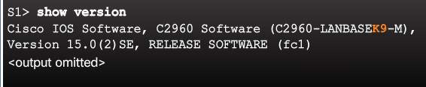
Secure Remote Access SSH Operation (Cont.)
A switch must have an IOS version (k9 at the end of the IOS file name) that includes cryptographic capabilities in order to configure and use SSH.
Use the show version command to see the IOS version.
Notes:
5.2 – Switch Security
5.2.1 – Secure Remote Access
5.2.1.1 – SSH Operation (Cont.)

Slide 23
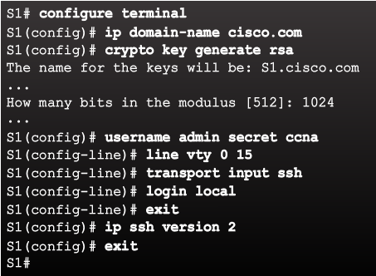
Secure Remote Access Configuring SSH
Commonly forgotten command that is used in key generation
Verify SSH support.
Configure the IP domain name.
Generate RSA key pairs.
Configure user authentication.
Configure the vty lines.
Enable SSH version 2.
Default is to accept both Telnet and SSH (transport input all)
The login local command forces the use of the local database for username/ password.
Notes:
5.2 – Switch Security
5.2.1 – Secure Remote Access
5.2.1.2 – Configuring SSH

Slide 24
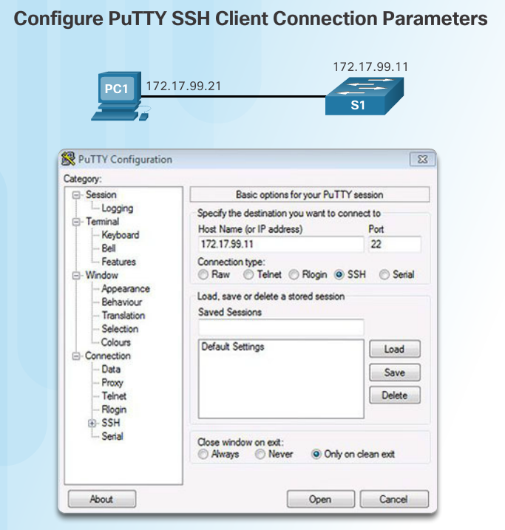
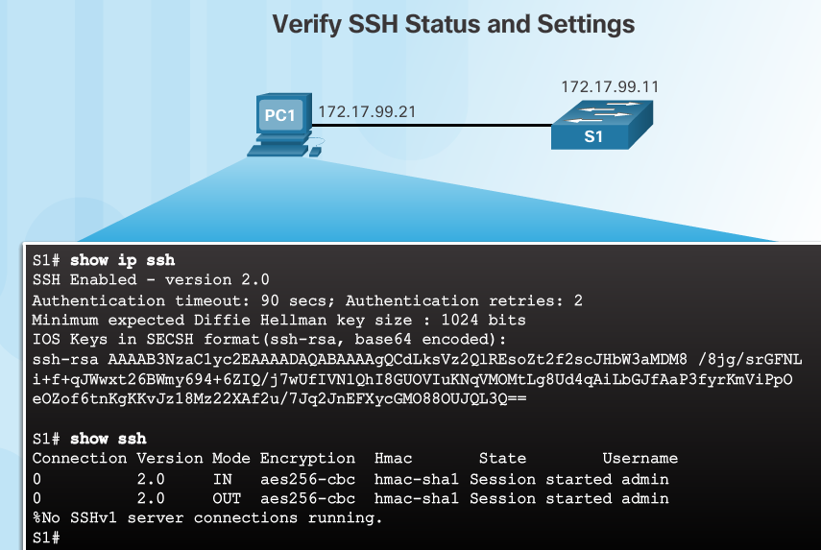
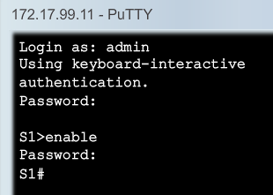
Secure Remote Access Verifying SSH
On the PC, connect to the switch using SSH.
Switch IP address
The PC is using SSH to communicate and issue commands on the switch.
Notes:
5.2 – Switch Security
5.2.1 – Secure Remote Access
5.2.1.3 – Verifying SSH

Slide 25
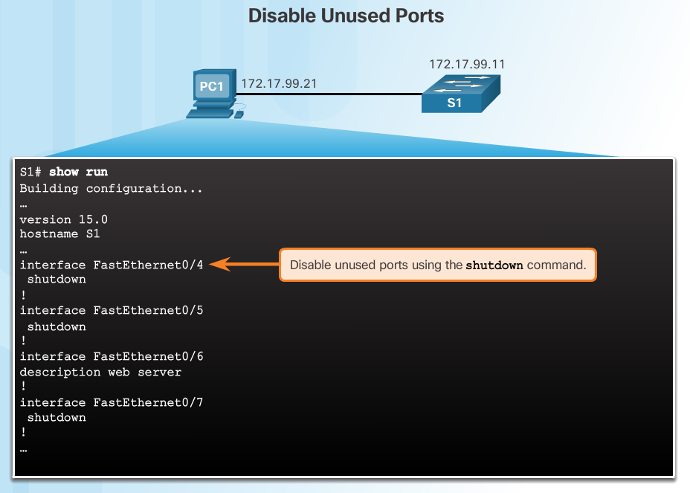
Switch Port Security Secure Unused Ports
The interface range command can be used to apply a configuration to several switch ports at one time.
Notes:
5.2 – Switch Security
5.2.2 – Switch Port Security
5.2.2.1 – Secure Unused Ports

Slide 26
Switch Port Security Port Security: Operation
Port security limits the number of valid MAC addresses allowed to transmit data through a switch port.
If a port has port security enabled and an unknown MAC address sends data, the switch presents a security violation.
Default number of secure MAC addresses allowed is 1.
Methods use to configure MAC addresses within port security:
Static secure MAC addresses – manually configure
switchport port-security mac-address mac-address
Dynamic secure MAC addresses – dynamically learned and removed if the switch restarts
Sticky secure MAC addresses – dynamically learned and added to the running configuration (which can later be saved to the startup-config to permanently retain the MAC addresses)
switchport port-security mac-address sticky mac-address
Note: Disabling sticky learning converts sticky MAC addresses to dynamic secure addresses and removes them from the running-config.
Notes:
5.2 – Switch Security
5.2.2 – Switch Port Security
5.2.2.2 – Port Security: Operation

Slide 27
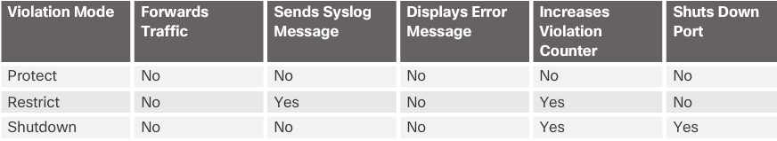
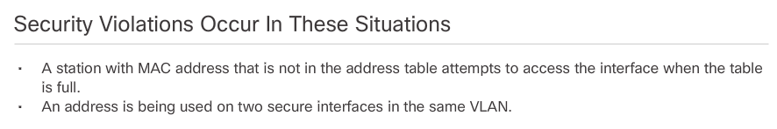
Switch Port Security Port Security: Violation Modes
Protect – data from unknown source MAC addresses are dropped; a security notification IS NOT presented by the switch
Restrict - data from unknown source MAC addresses are dropped; a security notification IS presented by the switch and the violation counter increments.
Shutdown – (default mode) interface becomes error-disabled and port LED turns off. The violation counter increments. Issues the shutdown and then the no shutdown command on the interface to bring it out of the error-disabled state.
Notes:
5.2 – Switch Security
5.2.2 – Switch Port Security
5.2.2.3 – Port Security: Violation Modes

Slide 28
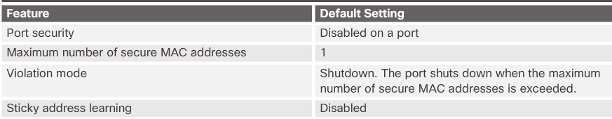
Switch Port Security Port Security: Configuring
Notes:
5.2 – Switch Security
5.2.2 – Switch Port Security
5.2.2.4 – Port Security: Configuring

Slide 29
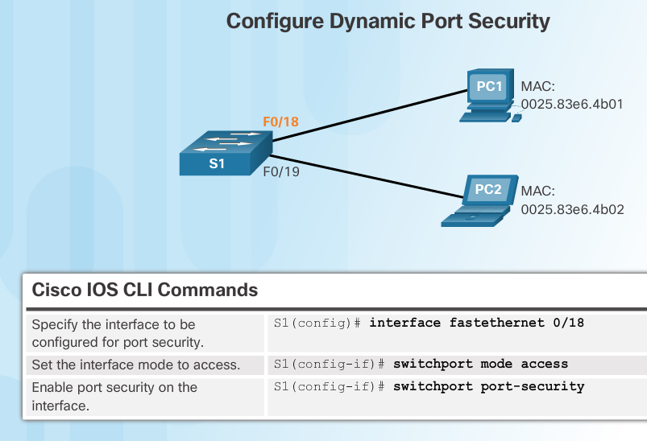
Switch Port Security Port Security: Configuring (Cont.)
Before configuring port-security features, place the port in access mode and use the switchport port-security interface configuration command to enable port security on an interface.
Most common configuration error is to forget this command!
Notes:
5.2 – Switch Security
5.2.2 – Switch Port Security
5.2.2.4 – Port Security: Configuring (Cont.)

Slide 30
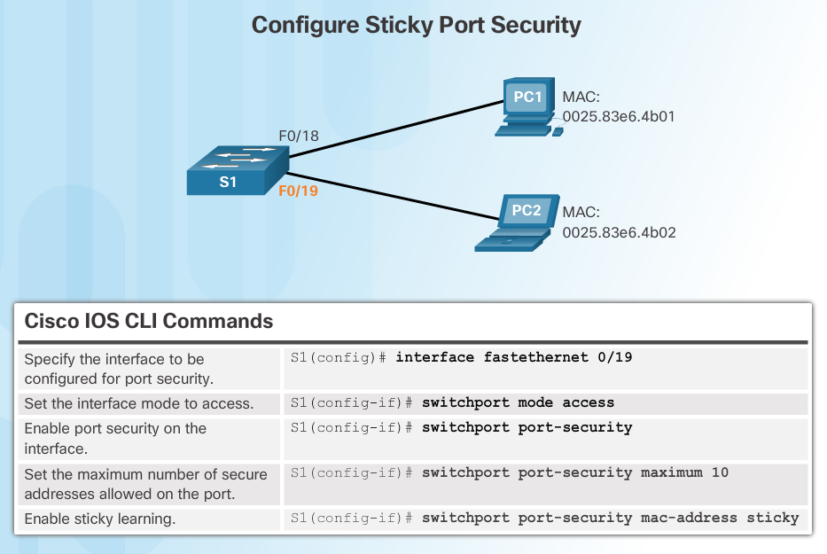
Switch Port Security Port Security: Configuring (Cont.)
Most common configuration error is to forget this command!
Notes:
5.2 – Switch Security
5.2.2 – Switch Port Security
5.2.2.4 – Port Security: Configuring (Cont.)

Slide 31
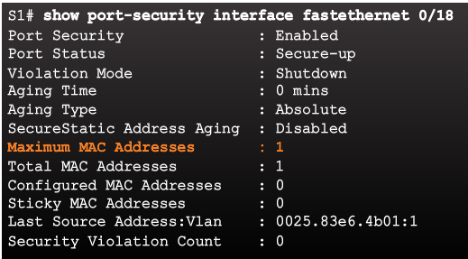
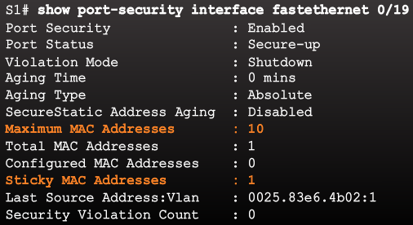
Switch Port Security Port Security: Verifying
Use the show port-security interface command to verify the maximum number of MAC addresses allowed on a particular port and how many of those addresses were learned dynamically using sticky.
Dynamic
Sticky
Notes:
5.2 – Switch Security
5.2.2 – Switch Port Security
5.2.2.5 – Port Security: Verifying

Slide 32
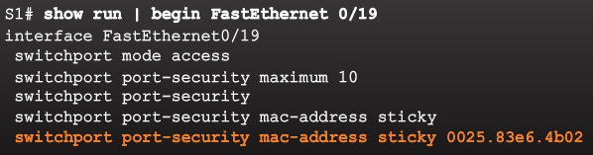
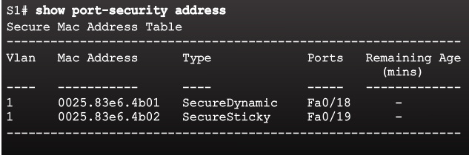
Switch Port Security Port Security: Verifying (Cont.)
Use the show running-config command to see learned MAC addresses added to the configuration.
The show port-security address command shows how MAC addresses were learned on a particular port.
Notes:
5.2 – Switch Security
5.2.2 – Switch Port Security
5.2.2.5 – Port Security: Verifying (Cont.)

Slide 33
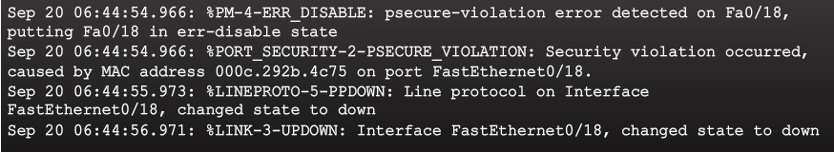
Switch Port Security Ports in Error Disabled State
Switch console messages display when a port security violation occurs. Notice the port link status changes to down.
Notes:
5.2 – Switch Security
5.2.2 – Switch Port Security
5.2.2.6 – Ports in Error Disabled State

Slide 34
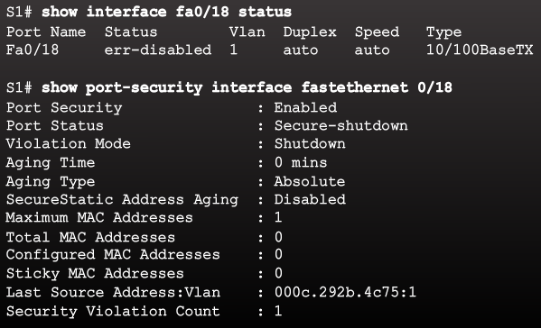
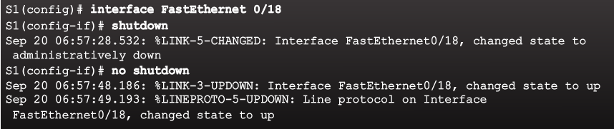
Switch Port Security Ports in Error Disabled State (Cont.)
Check the port status and the port security settings.
Do not re-enable a port until the security threat is investigated and eliminated.
Notice that you must first shut the port down and then issue the no shutdown command in order to use the particular port again after a security violation has occurred.
Notes:
5.2 – Switch Security
5.2.2 – Switch Port Security
5.2.2.6 – Ports in Error Disabled State (Cont.)

Slide 35
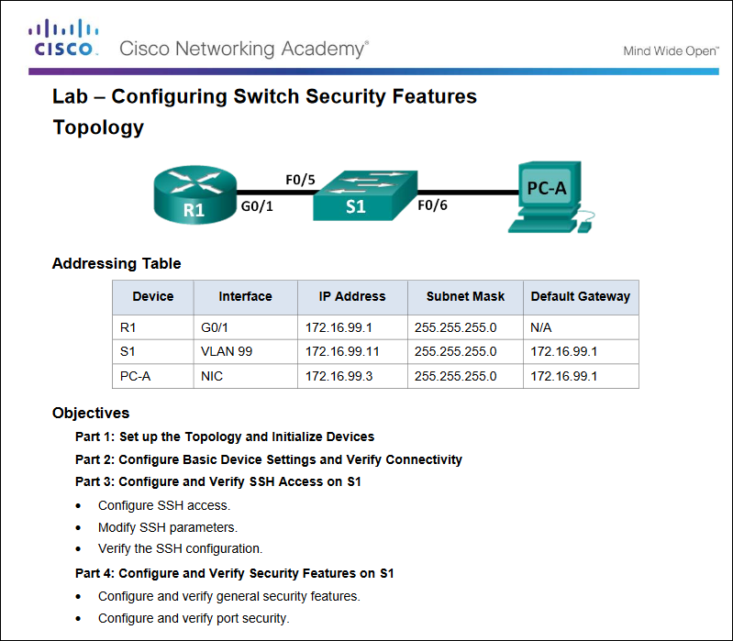
Secure Remote Access Packet Tracer – Configuring Switch Security Features
Notes:
5.2 – Switch Security
5.2.2 – Switch Port Security
5.2.2.9 – Lab – Configuring Switch Security Features

Slide 36
5.3 Chapter Summary
Notes:
5 - Switch Configuration
5.3 – Summary

Slide 37
Conclusion Chapter 5: Switch Configuration
Configure basic switch settings to meet network requirements.
Configure a switch using security best practices in a small to medium-sized business network.
Notes:
5.3 – Summary
5.3.1 – Conclusion
5.3.1.3 – Switch Configuration

Slide 38
Section 5.1 New Terms and Commands
POST Boot loader boot system command show boot command switch: prompt Mode button System LED Port LED SVI VLAN Management VLAN interface vlan command vlan command name command | Full-duplex Half-duplex Port speed duplex command speed command mdix command show interfaces command SSH configuration ip domain-name command crypto key generate rsa command transport input local command username secret command ip ssh version 2 command | login local command show ip ssh command Unused ports Port security switchport mode access command switchport port-security command switchport port-security maximum command switchport port-security mac-address sticky command show port-security interface command show port-security address command
Notes:
Chapter 5 - New Terms and Commands

